Slide 1
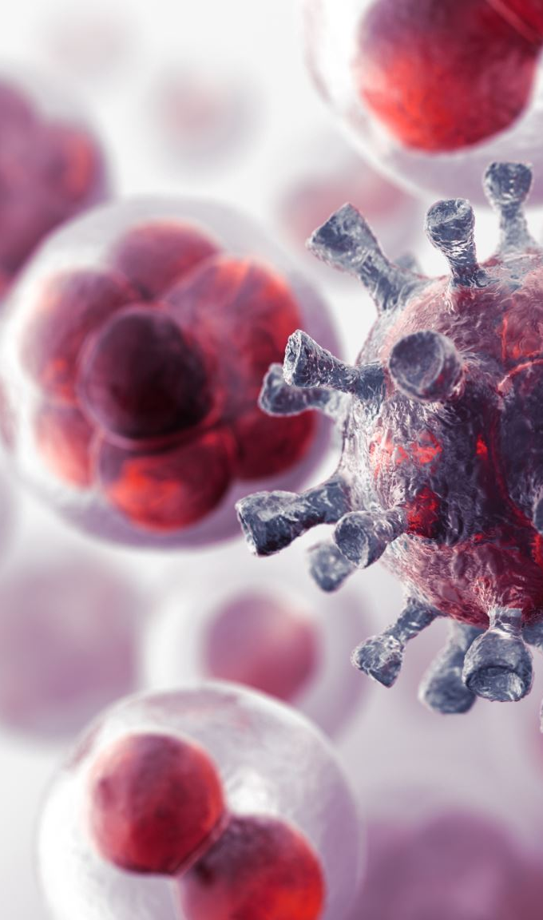
Predictive Model for Chronic Hepatitis B Infection
Group: Data Divers
Ahmed Bediwy
Farah Ahmed
Mubarak Mojoyinola
John Biju

Slide 2

Hepatitis B
The hepatitis B virus causes hepatitis B, a liver infection. The infection can be acute (short and severe) or chronic (long term).
Cirrhosis and liver cancer are two of the many potentially fatal outcomes of a chronic hepatitis B infection. Blood, saliva, vaginal fluids, and sperm can all be vectors for transmission. Furthermore, it can be transmitted from mother to child.
A vaccine against hepatitis B is present, and it is both safe and effective. Vaccines are routinely administered shortly after birth, with booster shots given a few weeks later. It's a near-perfect anti-virus solution.

Slide 3
NHANES Data Collection
NHANES 2013-2018
Demographics Data
Age, Gender, Race, Education, # of people in household, Annual income, Served active duty in US, Country of Birth, Marital Status, Pregnancy Status, Ratio of family income to poverty
Laboratory Data
Hepatitis B core antibody, Hepatitis B surface antigen
and Hepatitis B surface antibody

Slide 4
Questionnaires Data
Ever had hepatitis B, Ever received medicine for hepatitis B, Covered by private insurance, Covered by Medicare, Covered by Medicaid, Covered by any health Insurance
Type for work done last week, Hours of work done last week, Smoked at least 100 cigarettes in life, Current self-reported height (inches), Current self-reported weight, Income from wages/salaries

Slide 5

Data Manipulation Using NumPy & Pandas
Selected important columns from every dataset
Merged all datasets by Sequence
Remove NA’s with mean/mode/median
Convert object type features into integer type
Change the column names

Slide 6

Visualizations Implemented

Slide 7
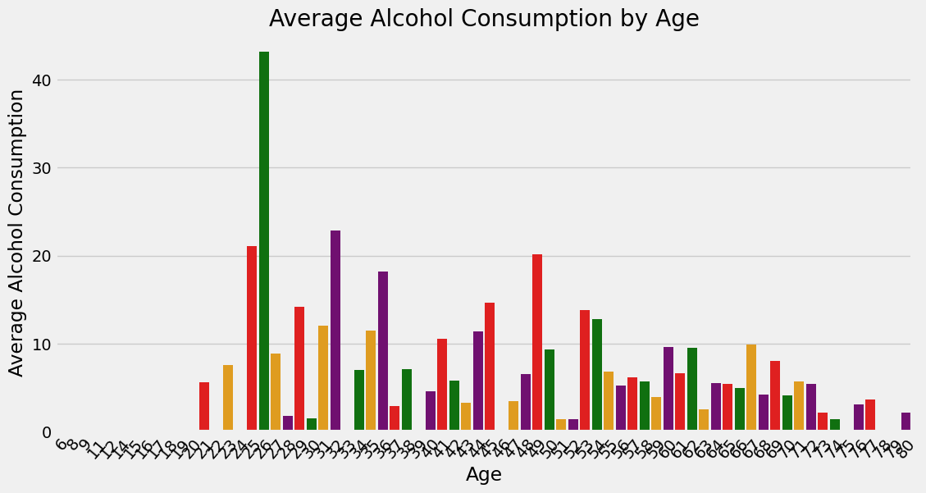

Slide 8
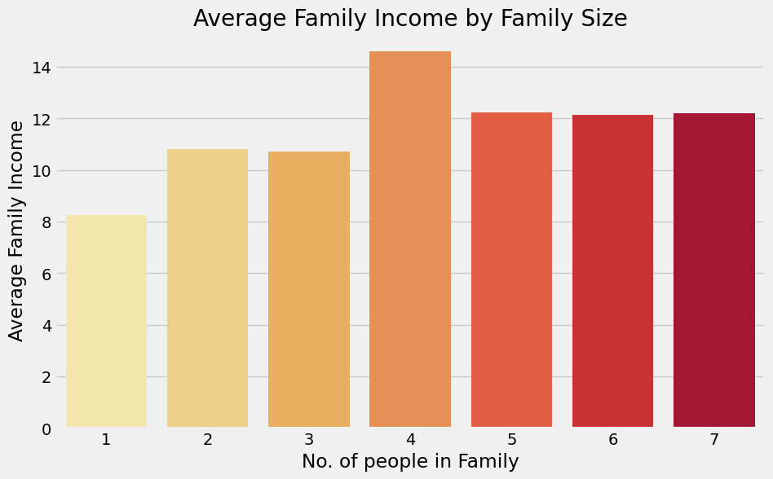
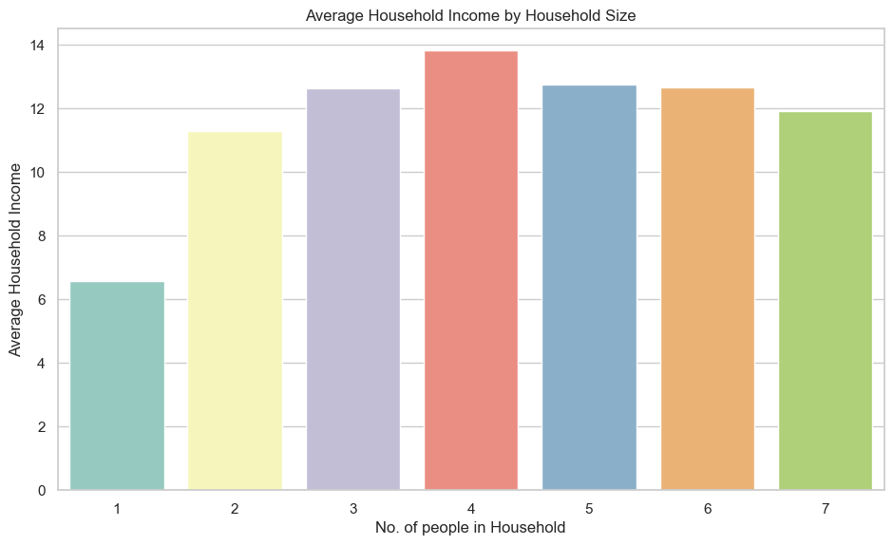
In analyzing household and family income, it has been observed that the presence of four individuals tends to result in a higher overall income.

Slide 9
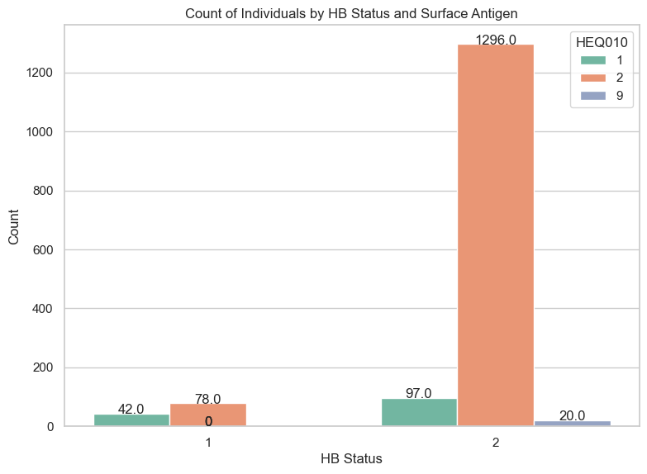
42 individuals who were informed they had the antigen tested positive. 78 individuals were not informed they had the antigen and tested positive. 97 individuals who were told they had the antigen tested negative. 1296 individuals were not informed they had the antigen and tested negative. 20% of individuals are unaware they have the antigen and receive a negative test result.

Slide 10
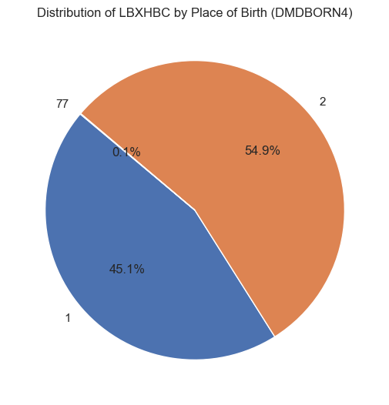
45.1% of the population are from United States

Slide 11
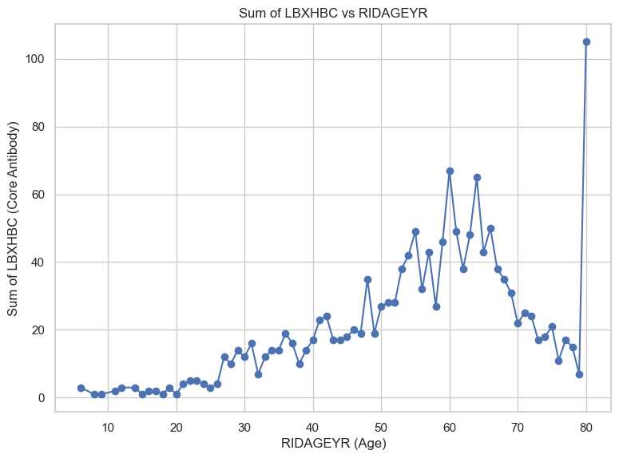

Slide 12
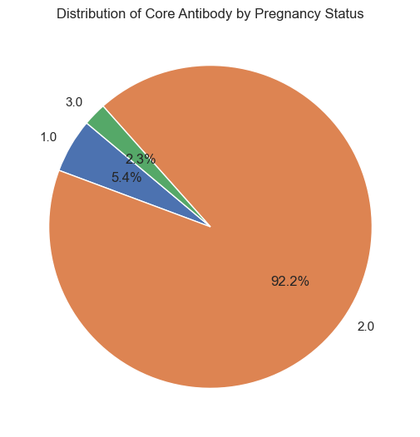
Core antibody testing during pregnancy reveals that 5.4% of pregnant women are positive for Hepatitis B.

Slide 13
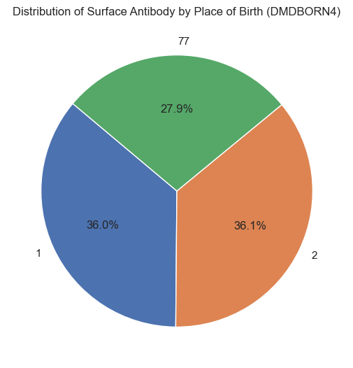

Slide 14
